Slide 1
Unconscious Bias
Unconscious biases are social stereotypes about certain groups of people that individuals form outside their own conscious awareness. Everyone holds unconscious beliefs about various social and identity groups, and these biases stem from one's tendency to organize social worlds by categorizing.
https://diversity.ucsf.edu/resources/unconscious-bias

Slide 2
Where does bias come from?
A human brain - though capable of filtering, prioritizing, categorizing, and summarizing huge amounts of information at a time - can only process about .000004% of the information that it takes in.
We've evolved to make up for this shortcoming through bias, which allows our brains to make quick decisions about environmental threats. Bias is what has allowed the survival of our species!

Slide 3
Types of bias
Confirmation Bias - We are more likely to remember evidence that supports our existing beliefs and to ignore evidence to the contrary.
Anchoring - We tend to rely too heavily on first impressions, using our initial assessment of a person or situation to make decisions, rather than all the available data.
Overconfidence Bias - We place too much weight on our own decision-making capabilities, knowledge, and opinions.
Gambler's Fallacy - We expect past events to influence the future, despite mathematical odds. For example, if you've flipped a coin eight times and gotten heads each time, you are more likely to think to the ninth flip will be tails.

Slide 4
Types of bias (continued)
Attribution Error - When we do something poorly, we tend to credit the poor performance to external factors (thinking of ourselves as victim of circumstance). When others perform poorly, we tend to think it's because of their inherent bad traits or lack of skill. The opposite is also true - when we perform well, we think it's because of our natural talent or high skill, but when others do well, we credit external factors rather than the individual.
Horns and Halos Bias - We assume that someone is overwhelming good or overwhelming bad, based on one or two overarching behaviors
Recency Bias - We allow recent trends and patterns to overshadow past actions or additional information and assume that the trends will continue.
Contrast Error - We tend to compare data only to the most similar data and lose site of the bigger picture. For example, when the majority of a team is low or high performance, an employee being rated in comparison may appear high (but only against low-performing peers) or low (but only against high-performing peers).

Slide 5
Does bias affect our team?
What biases are we aware of?
How does bias affect:
Interviewing?
Relationships?
Career development?
Decision making?
If so, how?

Slide 6
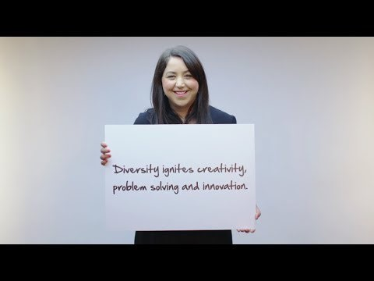
Inclusion starts with I

Slide 7
What is CDK doing to reduce bias?
Included in LEAD training for all managers and leaders
Reviewing how our benefits compare
HR are reviewing how bias is changing and how it is being reduced and even eliminated in our culture

Slide 8
Reducing bias
Use structure
Predefined and consistent criteria
Measure results
Collect data and look for patterns
Evaluate sublet messages
Body language and comments
Hold everyone accountable
Challenge assumptions
Respectfully call out bias

Slide 9
Want to learn more?
Sherbin, Laura and Ripa Rashid, "Diversity Doesn't Stick Without Inclusion,“ Harvard Business Review (2017)
Thinking Fast and Slow, Daniel Kahneman (2011)
Blind Spot, Mahzarin Banaji and Anthony Greenwald (2013)
Test your personal implicit associations: https://implicit.harvard.edu/implicit/

